Slide 1
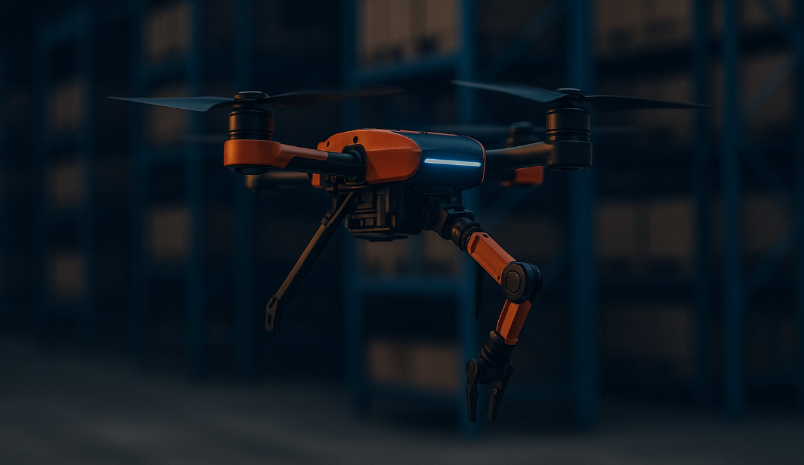
Pitch Presentation
Whole-Body control of a
Quadrotor with Manipulator
June 2025
Zhuohang Wu
John

Slide 2
0
Catalogue
1
1
Project Overview
4
Design & Methodology
2
Problem & Motivation
5
Progress & Next Steps
3
Related Work & Gap
6
Conclusion & Impact

Slide 3
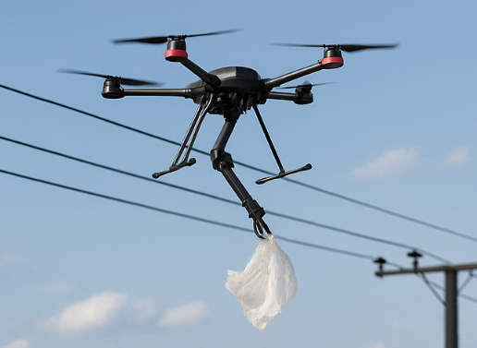
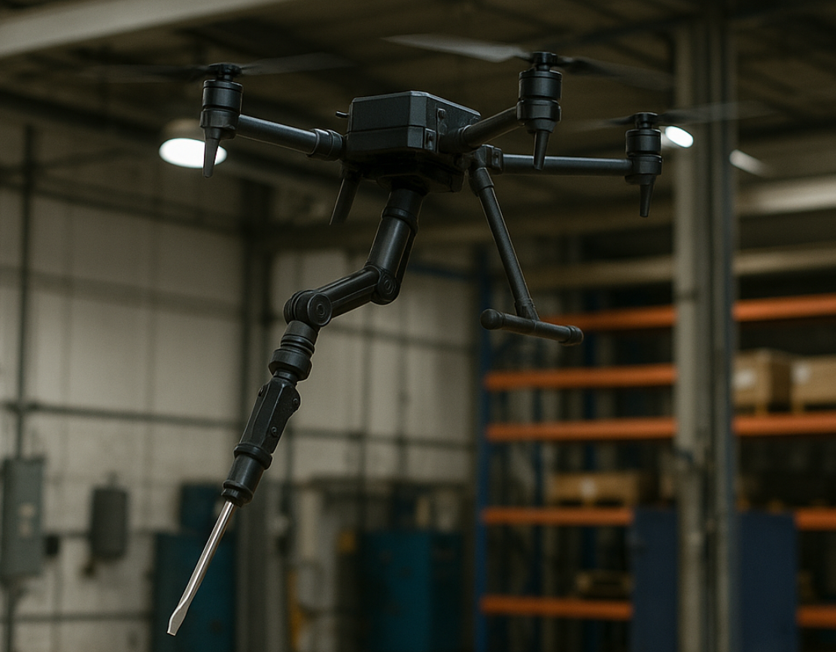
1
Introduction & Objective
·
A whole-body control framework
that integrates the dynamics of
a quadrotor and a robotic manipulator
for stable and precise aerial manipulation.
Application Areas | Core Topics
Remote inspection | Aerial manipulation
Lightweight logistics | Whole-body control
Environmental contact | Coupled dynamics
Notes:
The goal of this work is to develop a whole-body control framework that tightly couples the dynamics of a quadrotor and its onboard robotic arm, allowing the system to perform stable and precise in manipulation tasks.
This type of system has broad applications in remote inspection, lightweight object handling, many other places, where both mobility and flexibility are required.

Slide 4
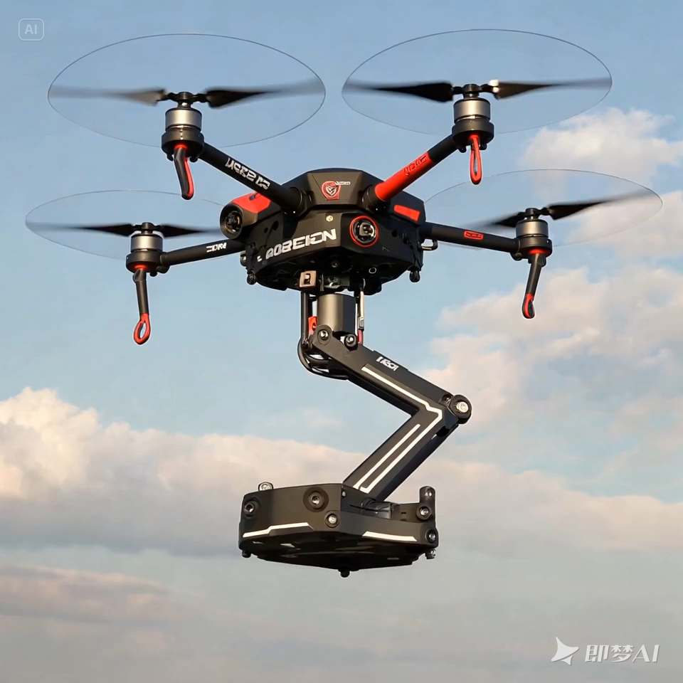
2
Why Whole-Body Control?
Problem
Conventional methods treat the quadrotor and manipulator as separate systems.
This leads to instability and poor tracking during dynamic manipulation tasks.
Aerial manipulation tasks require unified control of motion and force.
Notes:
In traditional systems, the quadrotor and the manipulator are controlled separately. But during dynamic tasks — like moving the arm while flying — the interaction forces can cause instability or loss of control.
These failures make the system unsuitable for real applications, where both flight stability and manipulation precision are required at the same time.
That’s why we need a whole-body control approach, which treats the entire platform as a single, tightly-coupled dynamic system.

Slide 5
3
Background & Research Gap
Existing Work
Paper | Contribution
Acosta et al., 2020 | Reliable nonlinear control for outdoor aerial manipulators
Saska et al., 2024 (IROS) | MPPI for agile UAVs – fast, adaptive, but no manipulator control
Limitations
Compare | Real-World | Whole-Body Control
Acosta et al. | ✅ | ❌
Saska et al. | ❌ (sim only) | ❌ (no manipulator)
This Project | ✅ | ✅
Focus only on drone dynamics
Lack of manipulator-drone coordination
Few real-world integrated implementations
Our Focus:
Implement and test a whole-body control strategy on a real integrated platform.
Notes:
Several works have explored advanced control strategies for aerial systems. For example, Acosta et al. proposed a nonlinear controller for outdoor drones with better stability. Saska et al. introduced an MPPI-based controller that allows agile UAV maneuvering.
However, most of these efforts focus only on the drone, without considering manipulator dynamics, especially in real-world conditions.
In this project, we aim to fill this gap by developing a whole-body control strategy and validating it both in simulation and physical environments.

Slide 6
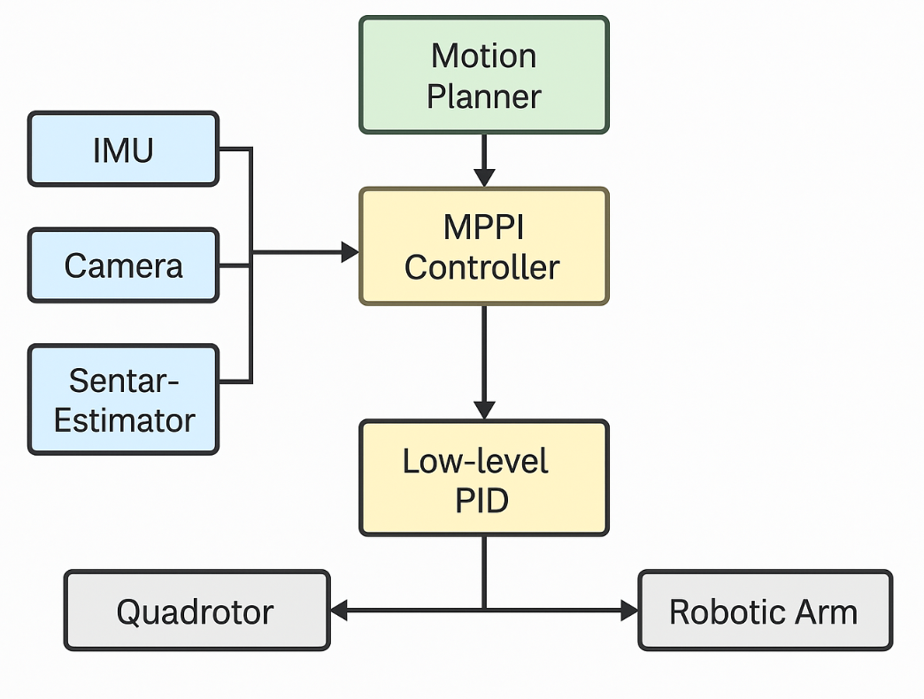

4
System Design & Control Methodology
System Overview
A custom quadrotor and a lightweight robotic arm.
Control system using Python and ROS, sim in Gazebo.
Hardware modeled in URDF and controlled via ROS.
Control Strategy
PID Control: simple baseline, used for comparison.
MPPI Control: for optimal and stable performance.
Focus is on whole-body coordination.
Unlike decoupled system, we treat drone and arm as a single body for high stability and precision.
Notes:
This system combines a custom quadrotor with a lightweight robotic arm, modeled in URDF and controlled using ROS and Python, with simulation in Gazebo.
We designed two control strategies: a simple PID controller as baseline, and an MPPI controller for optimal whole-body coordination.
As shown in the diagram, sensor data flows through a state estimator into the MPPI planner, which then outputs commands refined by a low-level PID layer.

Slide 7
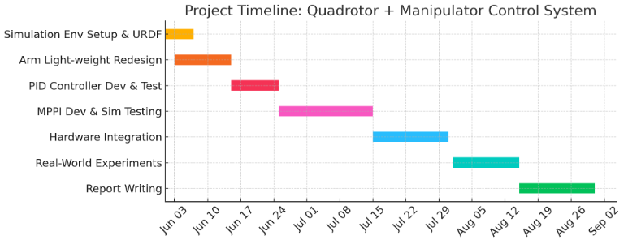
5
Current Progress & Development Roadmap
Notes:
This timeline shows the complete development roadmap from early June to the end of August. In the first two weeks, I’m focusing on finalizing the manipulator design and completing its URDF model in the simulation environment.
Starting mid-June, I will develop and test a PID baseline controller, and then move on to implementing a whole-body MPPI controller for the integrated system.
The second half of July will be dedicated to hardware integration and real-world deployment.
In August, I’ll conduct physical experiments to validate the control strategy, and reserve the final two weeks for detailed evaluation and report writing.

Slide 8

6
Conclusion & Future Outlook
Summary
Application Potential
Future Outlook
Implemented a sim env and integrated manipulator model
Designed a whole-body control strategy to coordinate drone + arm
Project progressing toward real-world validation in Summer 2025
Environmental inspection with physical interaction
Lightweight object pickup and delivery
Infrastructure maintenance in hard-to-reach areas
Add visual feedback (e.g., AprilTags or neural visual servoing)
Extend to multiple drones performing cooperative tasks
Replace MPPI with fast, real-time MPC for better responsiveness
Notes:
This project explores a whole-body control approach for aerial manipulation, where the drone and manipulator act as a single dynamic system.
Such systems could support environmental inspection, object delivery, and maintenance in hard-to-reach spaces, where both mobility and flexiblity are needed.
Future extensions may include integrating visual feedback, enabling cooperative multi-drone systems, and transitioning from MPPI to real-time MPC for better responsiveness.
Ultimately, this work lays the foundation for intelligent, interactive flying robots capable of physically engaging with their environment.

Slide 9
Thank You!
Zhuohang Wu
John

